Slide 1
Understand the
Why
Outline the
Relationship
Initiate Key
Stakeholder buy-in
Foster Long-term
Commitment
Commit
Assess
Assess
Current State
Align
True-North
Design
Approach
Determine Degree of
Risk and Cost
Develop Plan for
Transformation
Improve
People System
Enhance
Strategy Deployment System
Redesign
Value Stream Systems
Optimize
Knowledge & Data System
Build
Daily Management System
Deploy
Sustain
Reinvigorate
Commitment to Principles
Optimize
Deployed Systems
Activate
Sustainability Strategies
Outside-In
Inside-Out
Inside-In
Reflect on
Strategic Position
Broader Spread
System Gains

Slide 2



The Evolution of a Healthcare Lean Leader – The Value

Slide 3



Understand the Gap
Set Direction
Harmonize the Charge
Champion the Cause
Compelling Case
#1
Align the Arrows
Clarity in Direction

Slide 4

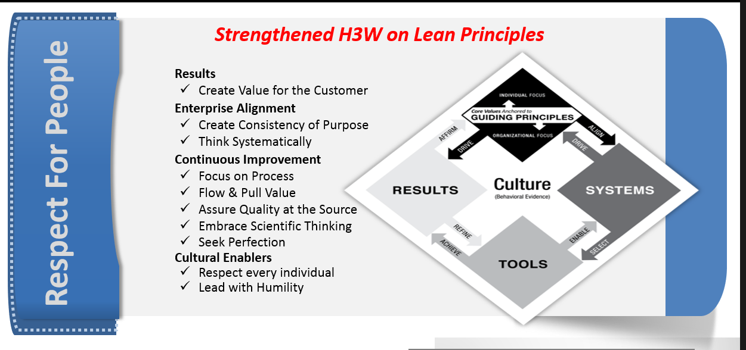
Build your Own Operating Model
Build on Heritage
Build your Systems on Lean Principles
Design your Systems to promote Respect for People Behaviors
#2
Lean Principle Based Architect
Inspire Innovation

Slide 5

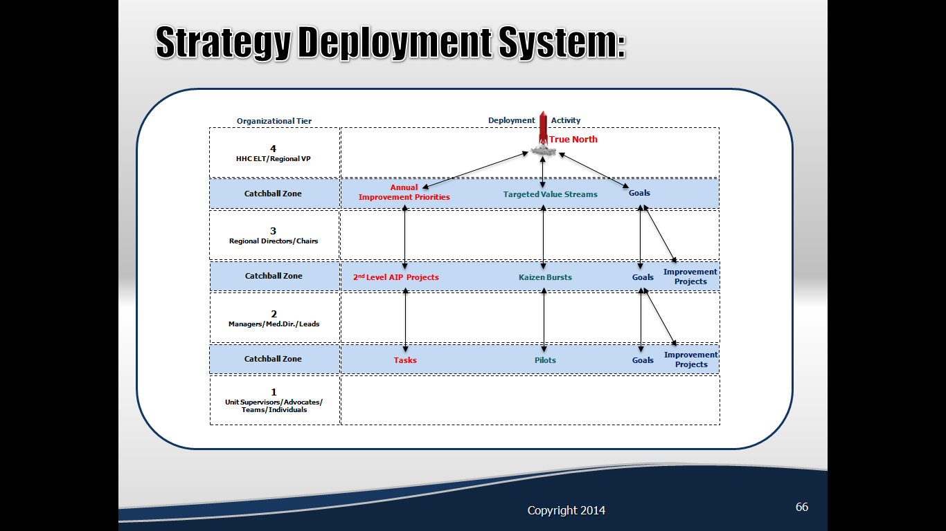
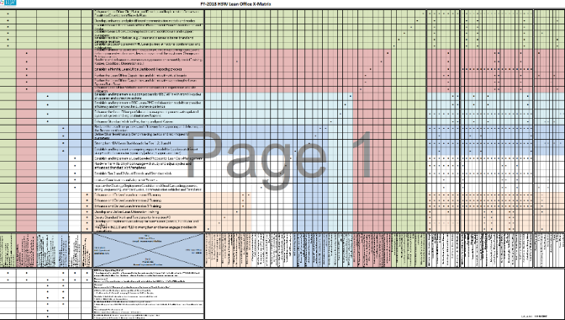
#3
Learn to say “No” to more initiatives
Flawless Execution
Align Goals
Avoid New Shiny Initiatives

Slide 6

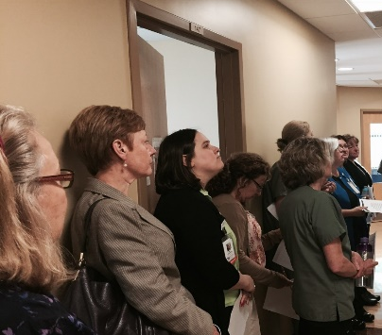
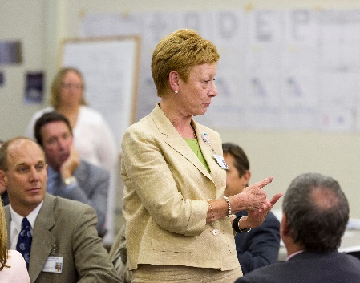
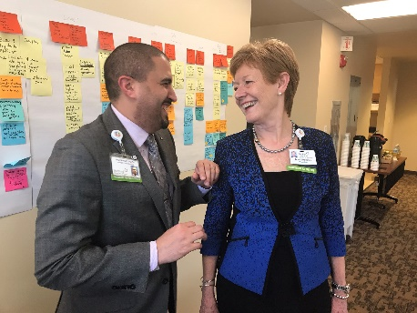
I am to Coach, Not Solve
#4
Foster a Safe & Fail-Fast Environment
You are not the Hero
No Substitute for Direct Observation
Have a Hypothesis to your Learning Cycles
Recognize
Fail-Fast Experiments

Slide 7
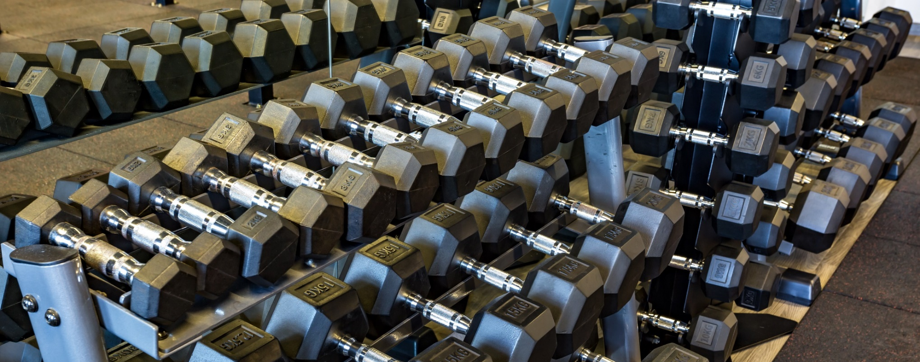
#5
Building Problem Solving Muscle
Deliberate Practice
Mindset – Go to the Gym to get Fit – “Be” Lean
Effectiveness – Address Root causes
Strength - Lifting heavier A3 Problems over time
Methodology incorporated into all problem-solving forums

Slide 8
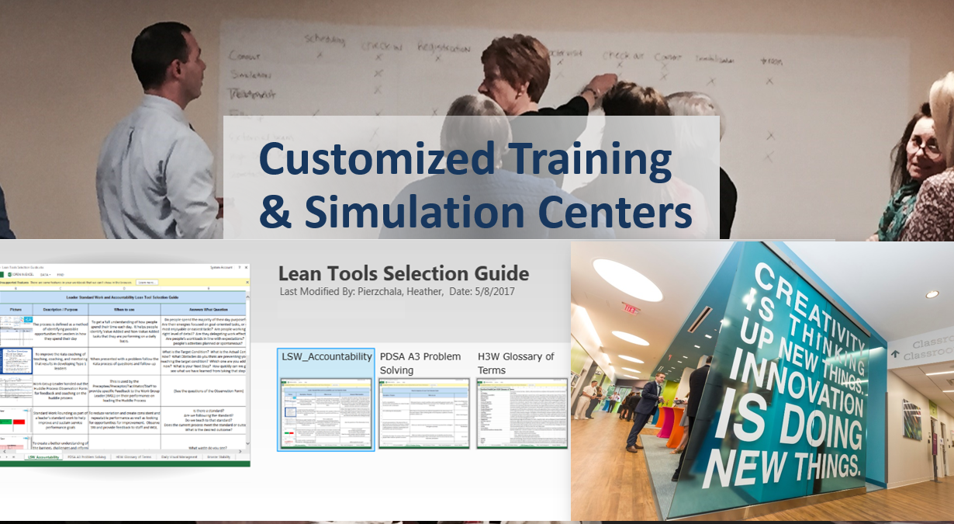
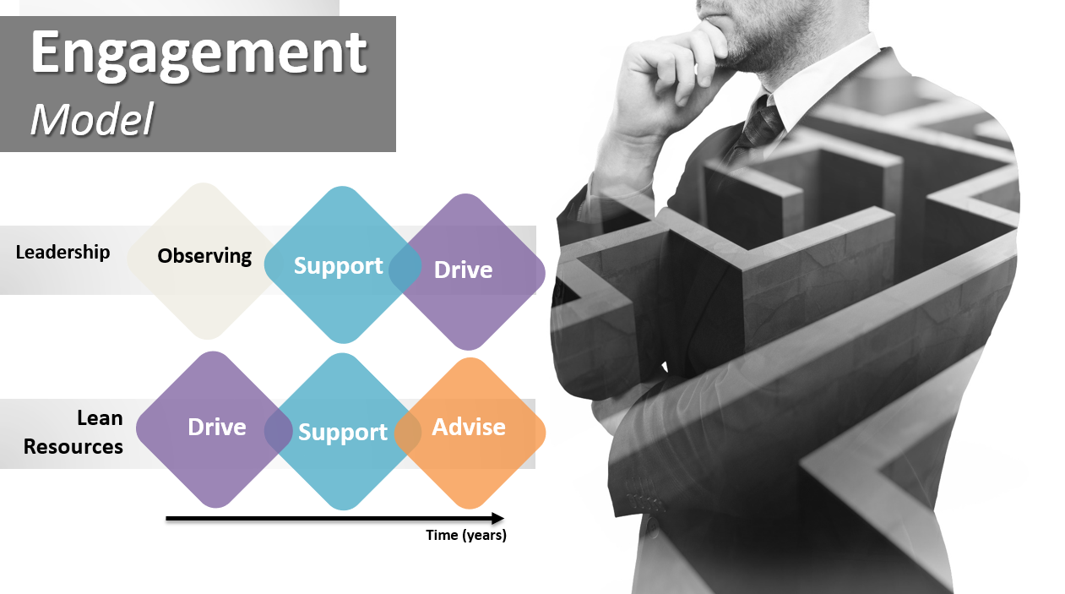
#5
Building Problem Solving Muscle
Deliberate Practice

Slide 9

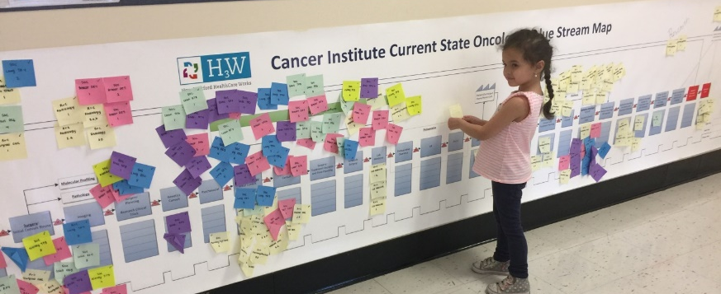
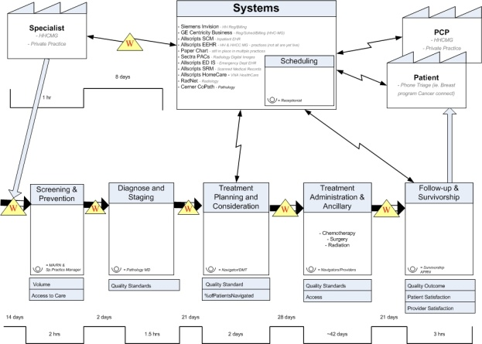
Redesign Value Streams
Fully Engaged
Get your Gloves Dirty
Focus on Freeing up capacity
Remove Barriers
#6

Slide 10

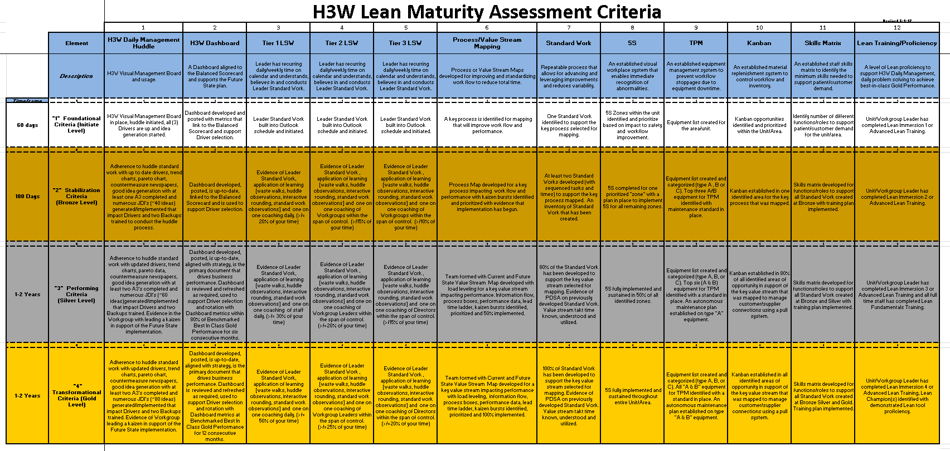
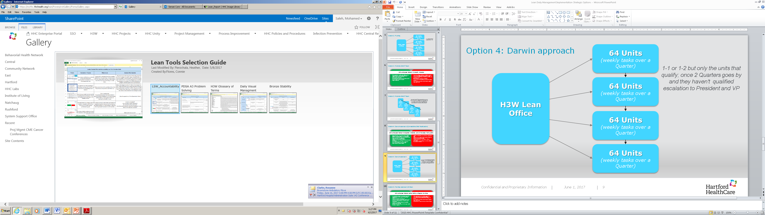
#7
Lean is a Long-Term Competitive Advantage
It’s a Journey
Production System

Slide 11
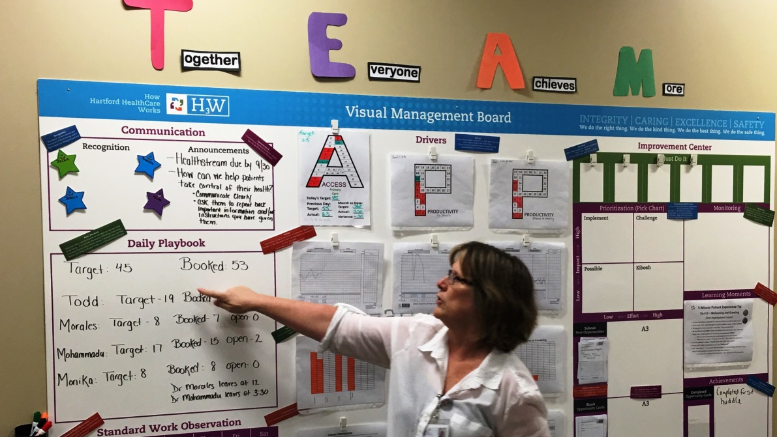

#8
Go Deep by Value Stream – Get it right
Visibility & Predictability

Slide 12
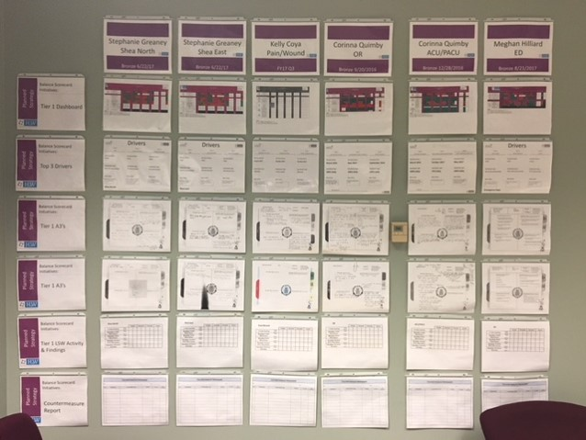
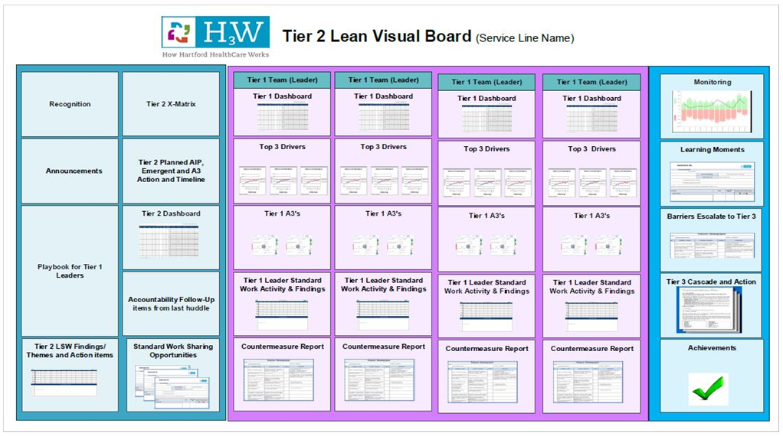
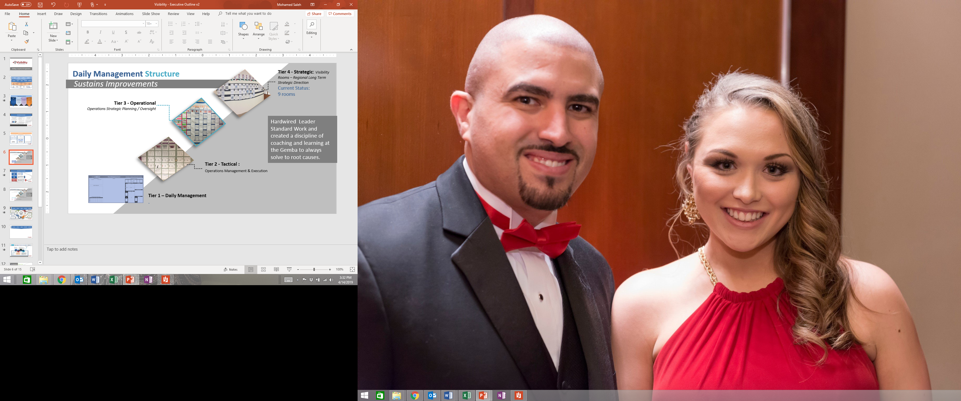
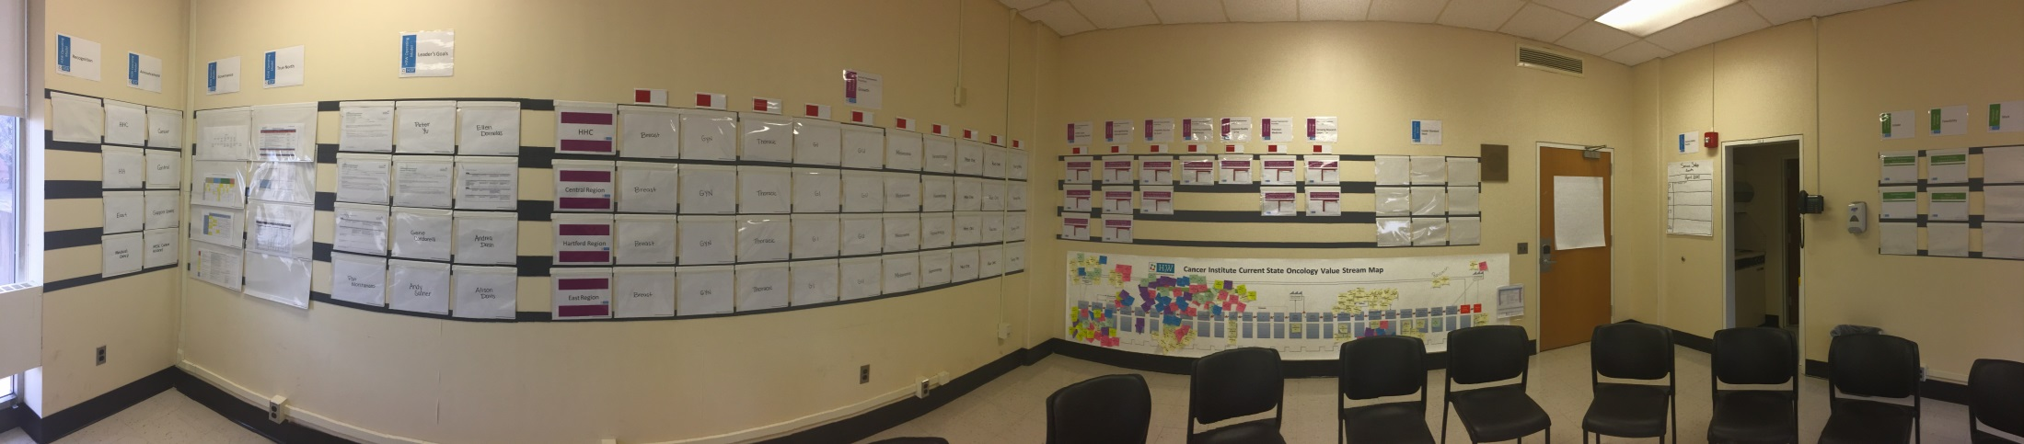
#9
Very Messy Process!
Living in Two Worlds
Trust the Process
Notes:
Tier 2 Huddles - Tactical : Operations Management & Execution

Slide 13
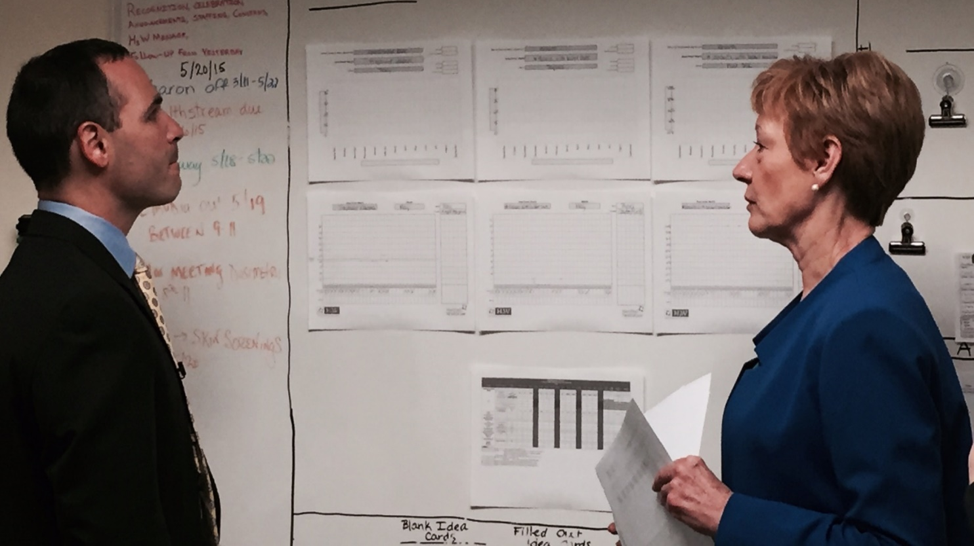
#10
The Glue to Sustaining the Gains
Adherence to Leader Standard Work!

Slide 14

People Development System
Develop Leader Standard Work Early
Creating Stability and Predictability by managing your capacity

Slide 15
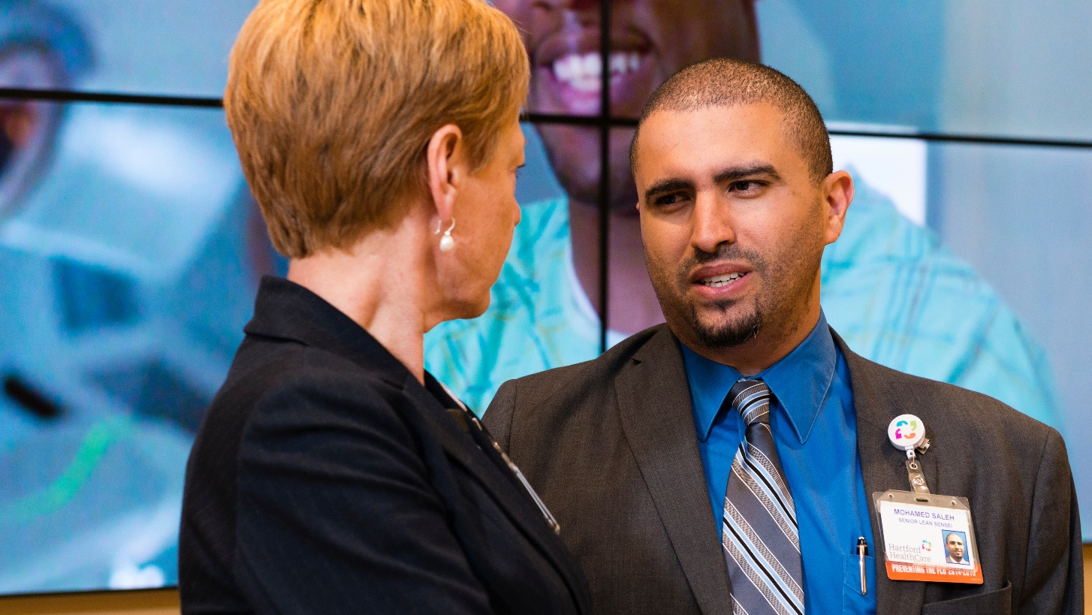
The Evolution of a Healthcare Lean Leader – Key Takeaways
Clarity in Direction
Inspire innovation
Flawless Execution
I am to Coach, Not Solve
Deliberate Practice
Fully Engaged
It’s a journey
Visibility & Predictability
Trust the Process
Adherence to Leader Standard Work

Slide 16

The Dunning-Kruger Effect
Understanding what it takes!
Arrogance
-Process Kaizen
-Standard Work
-Visual Management
-Visual Metrics
Learning Organization
-Building Culture
-Finding Solutions
-Learning Organization
Sustainable excellence
Confidence
Disappointment
-Sustainability
-Limited Adoption
Crossroads
-Ldr Std Work
-Advanced Problem Solving
Stability
Abandonment
None
Experience
Expert

Slide 17
The Dunning-Kruger Effect
Understanding what it takes!
At no point does the experts self confidence ever reach that of the beginner
Confidence
None
Experience
Expert

Slide 18

Leadership Behaviors
Executive Coaching on
  Lean Principles
  Team Effectiveness
  Complexity Thinking
  Distributed Leadership
Executive Team
Leaders Role Model Specific Behavioral Disciplines until Feedback obtained
Middle Managers
Behaviors deployed with a set cadence to the front line
Front Line Leaders

Slide 19
Breakthrough
Breakthrough
Year 1
Year 2
Year 3
Year 4
Year 5
Top Level SD Obeya Room
Top Executive Wall
Governance/Tracking/Support
Strategic
2nd Level Down Visibility
Each Executive involved PSP/Kaizens
Value Streams/ Work Streams
Operational
Kaizens
A3
DM Just Do-its
Process Improvements
Tactical
Analytics

Slide 20
Design Approach to Deployment
Tree Model
Network
School
Areas Supporting Breakthrough
ES
MS
HS
Daily Management (Visual Board, Leader Standard Work)
Maturity Journey (Bronze/Silver/Gold)
Immersion Redesign Training

Slide 21
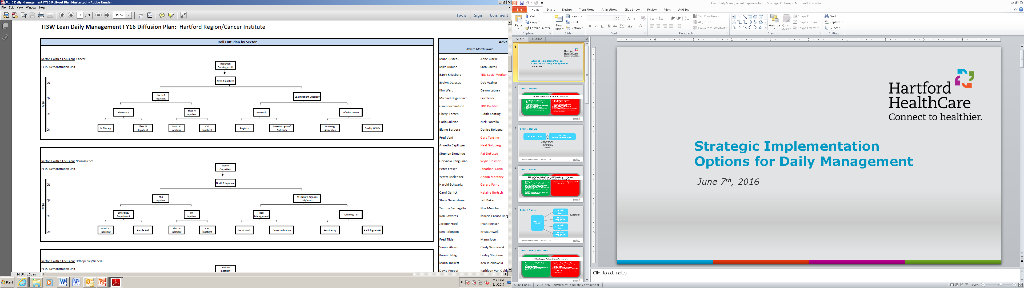
Design Approach – Go Deep by VSM
Champion/ Preceptor Model
Notes:
Focus on the “least waste way”.
Improves Safety & Quality
Utilize people creativity to improve upon the “standard”.
Increase Productivity
Stabilizes On-time Delivery
Simplifies a stable, repeatable methods - everywhere
Reduces Cost
Improves Morale
Foundation for continuous improvement

Slide 22
Design Approach to Deployment
Wide
Network
School
  Top Down message cascade
  Dashboard Development
  A3 Training
  Idea generation sessions
  Measuring ideas/employee

Slide 23
Core Lean Technology/Resource Needs
Strategy Deployment Software
Interactive Website
Governance/ Resources
Process Mapping Software with Standard Work Warehousing
Business Analytics
Maturity Assessment Tool

